Slide 1
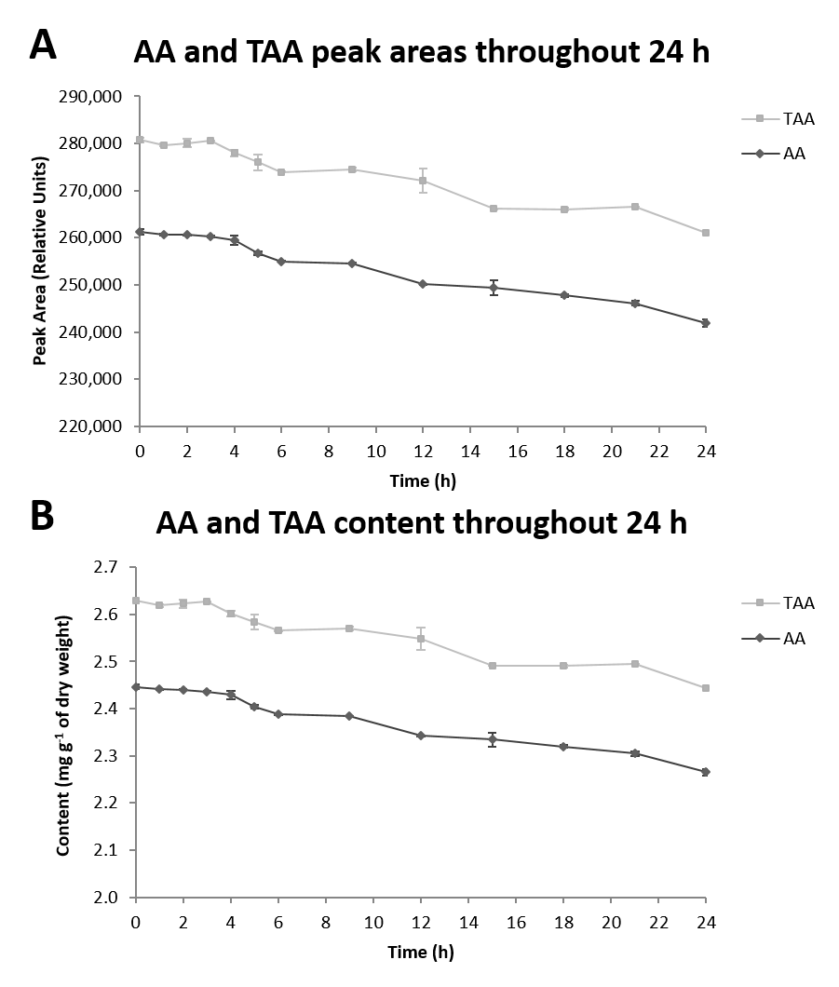
Supplemental File 1. AA and TAA stability at 5 °C over 24 h. (A) AA and TAA peak areas throughout 24 h. (B) AA and TAA content (mg g⁻¹ of dry weight) throughout 24 h. Bars represent the standard deviations of two technical replicates (n=2) kept in the autosampler at 5 °C and protected from exposure to light.

